Slide 1

DevOps Fundamentals Introduction to DevOps

Slide 2

DevOps Story

Slide 3

Traditional Development and Operations
DEV
OPS
c

Slide 4

“DevOps is development and operations collaboration”
“DevOps is treating your infrastructure as code”
It’s DevOps!
It’s DevOps!
“DevOps is using automation”
It’s DevOps!
“DevOps is feature switches”
It’s DevOps!
“DevOps is small deployments”
“Kanban for Ops?”

Slide 5






DevOps: the three stage conversation
DEV
OPS
1
People
2
Process
3
Products

Slide 6







The consequences of inefficiency
40
%
… of implementations end up getting reworked because they don’t meet the users’ original requirements
IT drives business
success!
High IT performance correlates with strong business performance, helps boost productivity, market share and profit.
Outperforming teams are
collaborate
54
%
extensively
more likely to
41
%
… of development budgets for software, IT staff and external professional services will be consumed by poor requirements
with their
Collaboration blockers
counterparts
80
%
failure rate …
26.7% No executive support
56.7% Cultural inhibitors
43.3% Fragmented processes
… for companies that try to adapt their existing tools for DevOps practices
Developers
IT Ops
%
Business
70
o
f
CIOs
Would increase risk
1 in
6
It takes on average 200 minutes to diagnose and repair a production issue
IT decision makers is still unfamiliar with the term DevOps
to reduce IT costs
and accelerate business agility
3/4
of teams
DevOps was being initiated by more development teams than IT Ops teams by about a 40% to 33% margin
The average hourly cost of infrastructure failure is $100,000 per hour
A bug caught in production ends up costing
than if the same bug was found earlier in the development cycle
Responding to ongoing needs for efficiency and growth
100x more
have adopted
Agile methodologies
dual goals
Always keeping all systems safe and secure

Slide 7
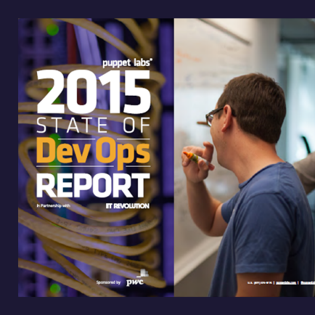
DevOps Benefits
Strong IT Performance is a competitive advantage
Deploy code 30x faster
Firms with high-performing IT organizations were 2x as likely to exceed their profitability, market share, and productivity goals
and with 200x shorter lead time as compared to their lower-performing peers
Have 60x fewer failures
DevOps Practices improve IT performance
and recover from failure 168x faster as compared to their lower-performing peers

Slide 8
DevOps Frame
200 level Practices
300 level Product w/ Practice
100 level Overview
Azure Deployment Template with Azure Website + SQL DB
Infrastructure as Code
Chef Recipe with Linux VM on Azure
People, Process, Business Value, etc.
Visual Studio Team Services (git) + Jenkins (build)
Continuous Integration
Github + Visual Studio Team Services + Gradle

Slide 9
List of DevOps Practices
Infrastructure as Code (IaC)
Continuous Integration
Automated Testing
Continuous Deployment
Release Management
App Performance Monitoring
Load Testing & Auto-Scale
Availability Monitoring
Change/Configuration Management
Feature Flags
Automated Environment De-Provisioning
Self Service Environments
Automated Recovery (Rollback & Roll-Forward)
Hypothesis Driven Development
Testing in Production
Fault Injection
Usage Monitoring/User Telemetry
http://www.itproguy.com/devops-practices/

Slide 10
Tools / Products

Slide 11
Power of Azure with the control of the datacenter Introducing the Microsoft Azure Stack
APP INNOVATION
Windows Server
Linux
Windows Server
Linux
Hybrid
Hyper-scale
Enterprise-grade
Portal
IaaS | PaaS services
Portal
IaaS | PaaS services
Cloud-inspired infrastructure
Powered by Windows Server, Hyper-V, System Center, and Azure technologies
Cloud infrastructure
Microsoft Azure Stack
Datacenter
Microsoft Azure

Slide 12

























Open + Flexible
Management
Hyper-scale
Open & flexible
Applications
Enterprise proven
App Frameworks
Hybrid
Databases & Middleware
Infrastructure
Linux

Slide 13













Visual Studio Team Services
Enables automation and Agile & DevOps practices
Open and extensible, supports your tools and technologies
Team Foundation Server
Flexibility with on-premises or cloud service
http://www.visualstudio.com/news/release-archive-vso

Slide 14






































Visual Studio Partners and Extensions
65
Visual Studio Code Extensions
5,910
Visual Studio Gallery Extensions
90
Visual Studio Sim-Ship Partners
48
VS Team Services Extensions

Slide 15
Resources

Slide 16
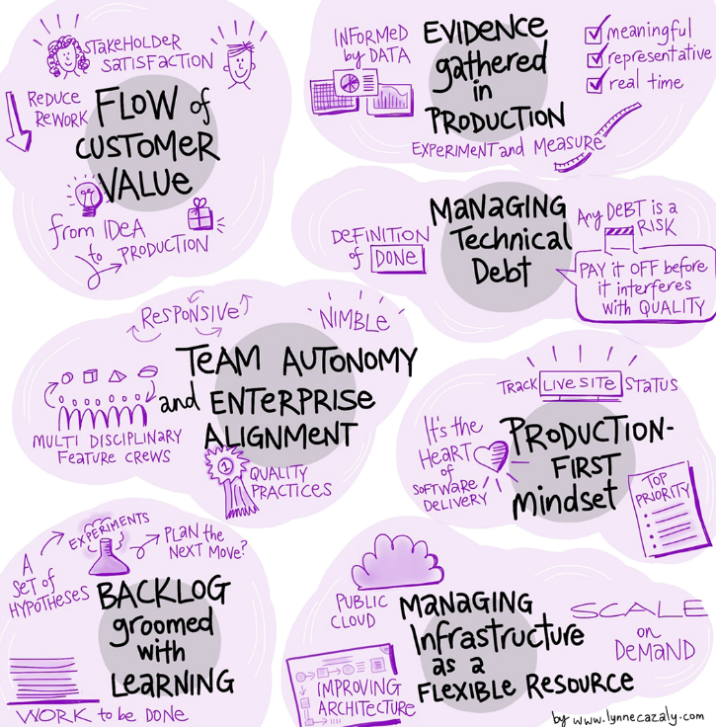
DevOps Maturity Assessment
OUR 7 HABITS FOR DEVOPS SUCCESS
Based on our experiences from our own transformation to a DevOps culture, we have identified DevOps habits and related DevOps practices that will lead to a true shift to DevOps in organizations of any size.
http://DevOpsAssessment.azurewebsites.net/

Slide 17

Microsoft’s DevOps Journey
http://aka.ms/OurDevOpsJourney
http://www.itproguy.com/how-microsoft-does-agile-devops-resources/

Slide 18
Resources for DevOps Practices
Accelerate your application delivery lifecycle
Optimize your DevOps practices and tools:
Get started on your DevOps journey: aka.ms/DevOps
DevOps Dimension Show on Channel 9
Continuous Improvement on your DevOps journey: aka.ms/DevOpsDimension
Technical resources for Practitioners:
Get access to free online training: aka.ms/DevOpsLearn
DevOps Maturity Self-Assessment
See where your organization is at across 7 areas: http://devopsassessment.azurewebsites.net/
Learn DevOps Practices hands-on with PartsUnlimited apps
http://aka.ms/PartsHOL

Slide 19



Happy DevOps
DEV
OPS
Production

Slide 20

© 2015 Microsoft Corporation. All rights reserved. Microsoft, Windows and other product names are or may be registered trademarks and/or trademarks in the U.S. and/or other countries.
The information herein is for informational purposes only and represents the current view of Microsoft Corporation as of the date of this presentation. Because Microsoft must respond to changing market conditions, it should not be interpreted to be a commitment on the part of Microsoft, and Microsoft cannot guarantee the accuracy of any information provided after the date of this presentation. MICROSOFT MAKES NO WARRANTIES, EXPRESS, IMPLIED OR STATUTORY, AS TO THE INFORMATION IN THIS PRESENTATION.

